Slide 1


Health Economics Lecture #5
Topic: Physician Behaviour Economics MSMG 5240
Prepared by Jacob Smith, Trent University

Slide 2
Learning Objectives
In this lecture, we will discuss:
The Physician’s Problem.
Theory I: The Physician as a Profit-Maximizing Firm.
Theory II: The Target Income Hypothesis and Supplier-Induced Demand.
Empirical Evidence supporting each theory of physician behaviour.
Goal of this Lecture:
Describe the nature of physician behaviour.
Discuss why the market for medical care is different than other markets.

Slide 3
The Physicians Problem

Slide 4




A Review of the Theory of the Firm and Markets
In markets for nonmedical services the incentives differ.
Firms try to sell products at the right price and amount which maximizes profits.
Consumers make purchasing decisions as ones that maximize their utility.
Price
Price
$$P^{∗}$$
Price
$$Q^{∗}$$
Quantity
Quantity
Quantity

Slide 5
The Market for Medical Services
The market for medical services is quite different from other markets due to 3 factors:
Asymmetry of Information - Physicians often have a better sense on the optimal amount and type of treatment to provide patients compared to patients themselves.
Altruism- Physicians are often considered as (partially) “ethical” suppliers of health care who think of patient well-being when determining their provision of care in addition to their own incomes.
Third Party Payment- Physicians are often not paid directly by patients,but are instead paid by a third party for their services (i.e. an insurance company).
Physicians
Consider both patient well-being and their incomes.
Has more information about patient health status compared to patient.
Patients
Typically have an Inelastic demand for health care.
Often does not pay for health care directly.
Has less information about own health status compared to physicians.
Limited in profit maximization by patient condition.
Are often paid by patients indirectly (i.e. through insurance).

Slide 6



The Physician’s Dilemma
Because the physician possesses superior information regarding patient health status, there is an incentive to provide less efficient care.
These can manifest themselves as:
Increased unnecessary diagnostic tests.
“upcoding” (billing for consult procedures which are not reflective of work done).
Requesting patient appointments when appointments are not needed.
This information asymmetry allows physicians to engage in Supplier Induced Demand.
Physician behavior is often a combination of profit-maximizing behavior and altruistic behavior

Slide 7
Theory I: The Physician as a Profit Maximizing Firm.

Slide 8
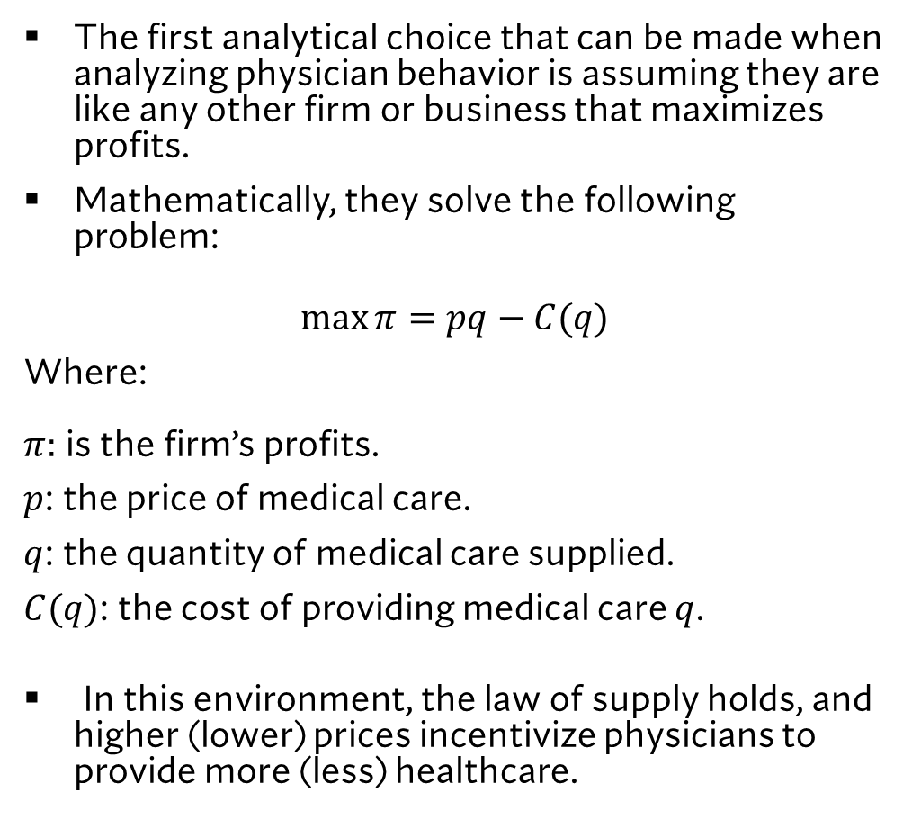


The Physician as a Profit Maximizing Firm
The first analytical choice that can be made when analyzing physician behavior is assuming they are like any other firm or business that maximizes profits.
Mathematically, they solve the following problem:
$$\max{π=pq−C(q)}$$
Where: $π:$ is the firm’s profits.
$p$: the price of medical care.
$q$: the quantity of medical care supplied.
$C(q)$: the cost of providing medical care $q$.
In this environment, the law of supply holds, and higher (lower) prices incentivize physicians to provide more (less) healthcare.
Price
Supply
$$P_{0}^{∗}$$
Demand
$$Q_{0}^{∗}$$
Quantity of Healthcare

Slide 9




The Physician as a Profit Maximizing Firm
Because of the information asymmetry that exists between patients and physicians, physicians can shift the demand for healthcare.
Price
Supply
$$P_{1}^{∗}$$
$$P_{0}^{∗}$$
$$D_{1}$$
$$D_{0}$$
$$Q_{0}^{∗}$$
$$Q_{1}^{∗}$$
Quantity of Healthcare

Slide 10


The Physician as a Profit Maximizing Firm
Regulated fees for medical care can offset this incentive.
In practice however the determination of “efficient fees” is often guess work.
Price
Supply
$$P_{1}^{∗}$$
$$Set Fee$$
$$P_{0}^{∗}$$
$$D_{1}$$
$$D_{0}$$
$$Q_{0}^{∗}$$
$$Q_{1}^{∗}$$
Quantity of Healthcare

Slide 11
Theory II: The Target Income Hypothesis and Supplier Induced Demand.

Slide 12


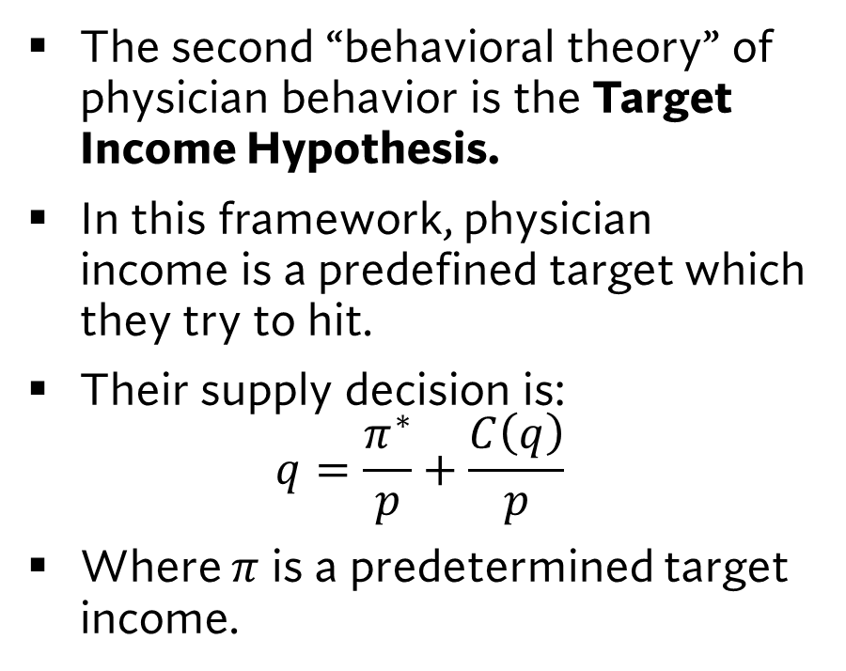


The Target Income Hypothesis
The second “behavioral theory” of physician behavior is the Target Income Hypothesis.
In this framework, physician income is a predefined target which they try to hit.
Their supply decision is: $q=\frac{π^{∗}}{p}+\frac{C\left(q\right)}{p}$
Where $π$ is a predetermined target income.
Price
$$p_{1}^{∗}$$
Physician Target Income
$$p_{2}^{∗}$$
Demand
$$q_{1}^{∗}$$
$$q_{2}^{∗}$$
Quantity

Slide 13
The Target Income Hypothesis
This framework, has MULTIPLE EQUILIBRIA.
These equilibria can be interpreted as different practice styles (high quantity at a low price; little care at a high price).
Price
$$p_{1}^{∗}$$
Physician Target Income
$$p_{2}^{∗}$$
Demand
$$q_{1}^{∗}$$
$$q_{2}^{∗}$$
Quantity

Slide 14




The Target Income Hypothesis
With the introduction of a regulated fee, there's no certainty regarding what can happen to equilibrium prices and quantities
We can even have results which contradict the law of supply.
For this reason the target income hypothesis is referred to as a behavioural theory.
Price
$$p_{1}^{∗}$$
Physician Target Income
Demand
$$p_{2}^{∗}$$
$$q_{1}^{0}$$
$$q_{1}^{1}$$
$$q_{2}^{0}$$
$$q_{2}^{1}$$
Quantity

Slide 15
Which Theory is True?
Some Empirical Evidence on Both Sides

Slide 16

The ambiguity of the role of price in the supply of physician procedures
Some Motivation for Empirical Work on Physician Behavior:
“… The reaction of fees and services per capita to fee level is ambiguous because the substitution effect calls for an increase in provision while the income effect calls for a decrease”
-Peter Zweifel (Health Economics, Chapter 8, Conclusion 8.2)

Slide 17
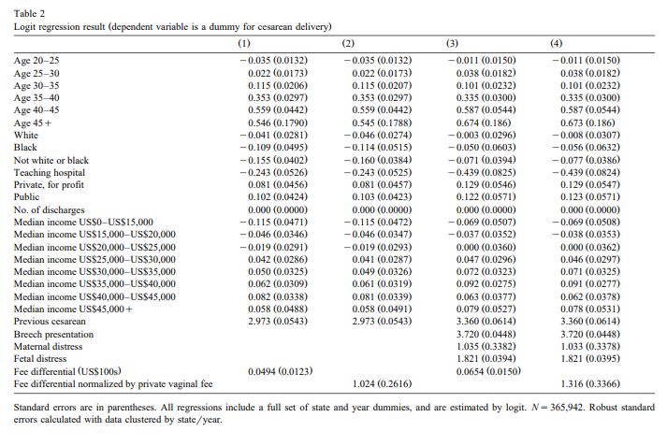
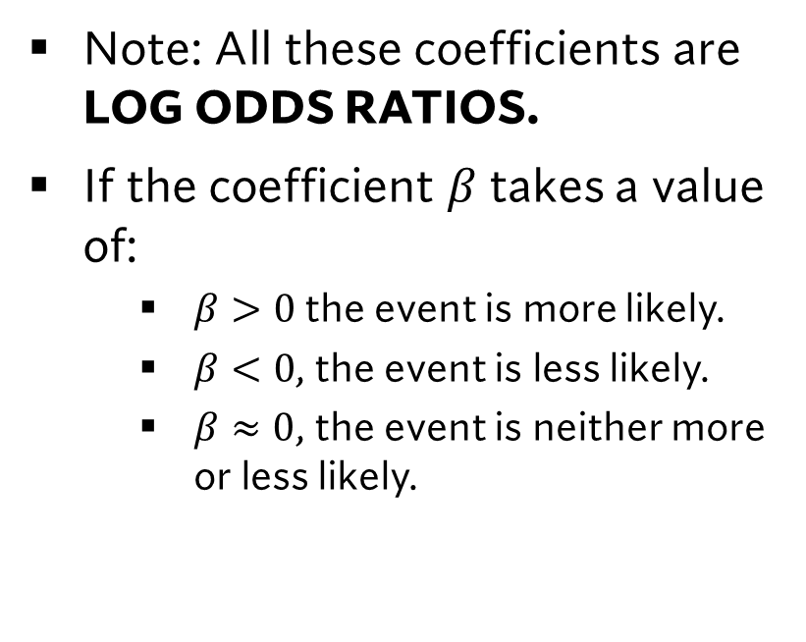
Gruber 1999:Physician fees and procedure intensity: the case of cesarean delivery
Note: All these coefficients are LOG ODDS RATIOS.
If the coefficient $β$ takes a value of:
$β>0$the event is more likely.
$β<0$, the event is less likely.
$β≈0$, the event is neither more or less likely.

Slide 18
Gruber 1999:Physician fees and procedure intensity: the case of cesarean delivery
This table shows how various factors impacted the likelihood of cesarean delivery in select US states.
Results show that conditional on the fee paid for normal birth, OBGYNs were incentivized to opt for cesarean delivery.
Practically: In US states where there were higher fees for cesarean delivery, there was a greater incentive to conduct them.
This can be read as “supplier-induced demand” or “income targeting” behavior.

Slide 19
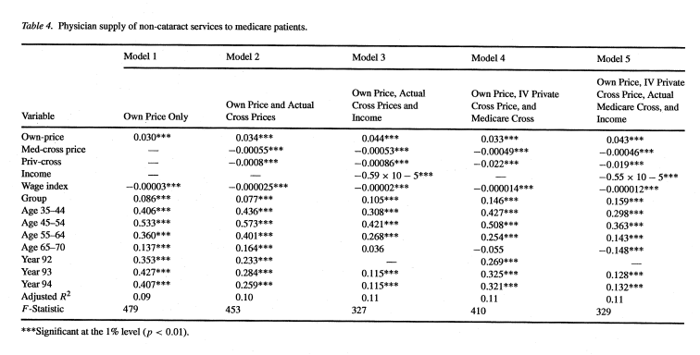
Mitchell, Hadley and Gaskin 2002: Spillover Effects of Medicare Fee Reductions: Evidence from Ophthalmology
The authors analyzed the effect of a reduction in the Medicare reimbursement rate for cataract surgery on the supply of cataract surgeries and non cataract surgery services.
This table shows the results for the own price effects of other services (which are aggregated as an index) and finds that the own price effects are positive.
This is a result that is consistent with ophthalmologists following the law of supply.

Slide 20
Issues with trying to detect Supplier Induced Demand
The evidence that was brought thus far changes the definition of supplier induced demand.
What was shown was that differences in reimbursement can result in differences in differences in the volume and mix of procedures.
SUPPLIER INDUCED DEMAND IS A RESULT THAT REQUIRES AN INCREASE IN QUANITITY SUPPLIED FOLLOWING A DECLINE IN FEE.
This contradicts the law of supply.
While the possibility of supplier-induced demand is present in the physician’s problem. It is empirically difficult to test.

Slide 21
Learning Objectives
In this lecture, we will discuss:
The Physician’s Problem.
Theory I: The Physician as a Profit-Maximizing Firm.
Theory II: The Target Income Hypothesis and Supplier-Induced Demand.
Empirical Evidence supporting each theory of physician behaviour.
Goal of this Lecture:
Describe the nature of physician behaviour.
Discuss why the market for medical care is different than other markets.

